Slide 1

CYCLISTIC BIKE SHARE ANALYSIS: UNDERSTANDING RIDER BEHAVIOUR
By: Tomi Jegede
Date: March 31, 2024

Slide 2
INTRODUCTION
Cyclistic is a bike share company that offers its services to customers in Chicago.
Customers who purchase single-ride or full-day passes are referred to as casual riders, while customers who purchase annual memberships are Cyclistic members.
This project analyses data from Motivate International Inc. to identify how the two group of riders differ from one another.

Slide 3
OBJECTIVES
The primary objective of this analysis is to gain a comprehensive understanding of ridership patterns, preferences, and behaviour among Cyclistic’s riders.
By analysing key metrics, this project aims to identify trends, patterns, and opportunities for improvement.
The insights derived from this analysis will guide recommendations for enhancing Cyclistic’s services, attracting more riders, and ensuring a seamless biking experience for all users.

Slide 4
ANALYSIS SUMMARY
This project identified key differences between Cyclistic members and casual riders using key metrics such as:
Average rides for each rider type in each month
Average trip duration(in minutes) for each rider type in each month
Peak weekday and hour for each rider type in each month
Preferred bike type for each rider
The common start and end stations for each rider type

Slide 5
METHODOLOGY
Data Sources- Divvy Trip Data provided by Motivate International Inc.
Analysis Tools- Excel, SQLite, Tableau, R

Slide 6
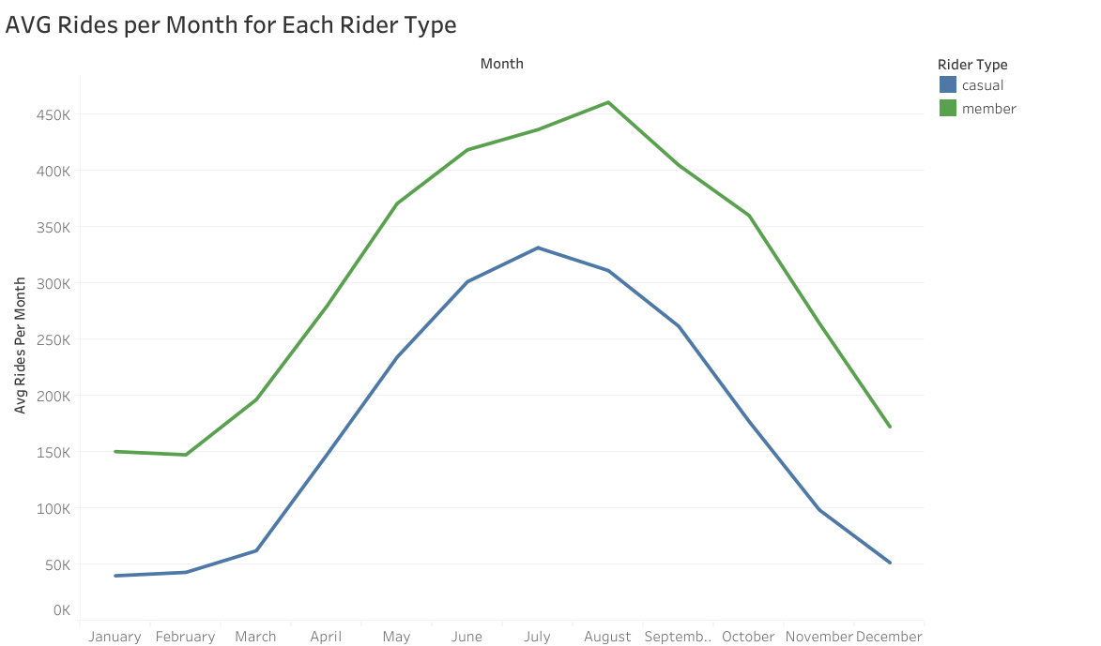
ANALYSIS BASED ON KEY METRICS
Average rides for each rider type in each month
The results show that Cyclistic members have a higher ride count for each month when compared to casual riders.
June to August are the peak months for both Cyclistic members and casual riders.
December to February witnessed the lowest ride count for the two member types.

Slide 7
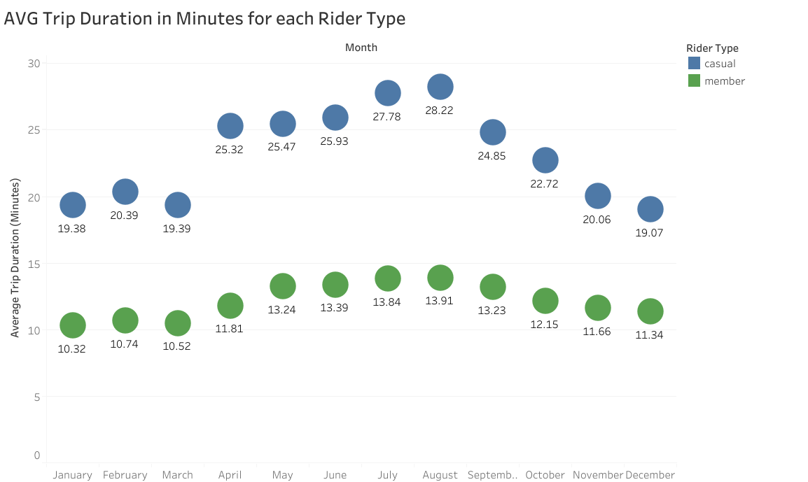
ANALYSIS BASED ON KEY METRICS
Average trip duration(in minutes) for each rider type in each month
The results show that the average trip duration(in minutes) for casual riders is higher than that of Cyclistic members for each month.
More research has to be carried out to understand this result.

Slide 8
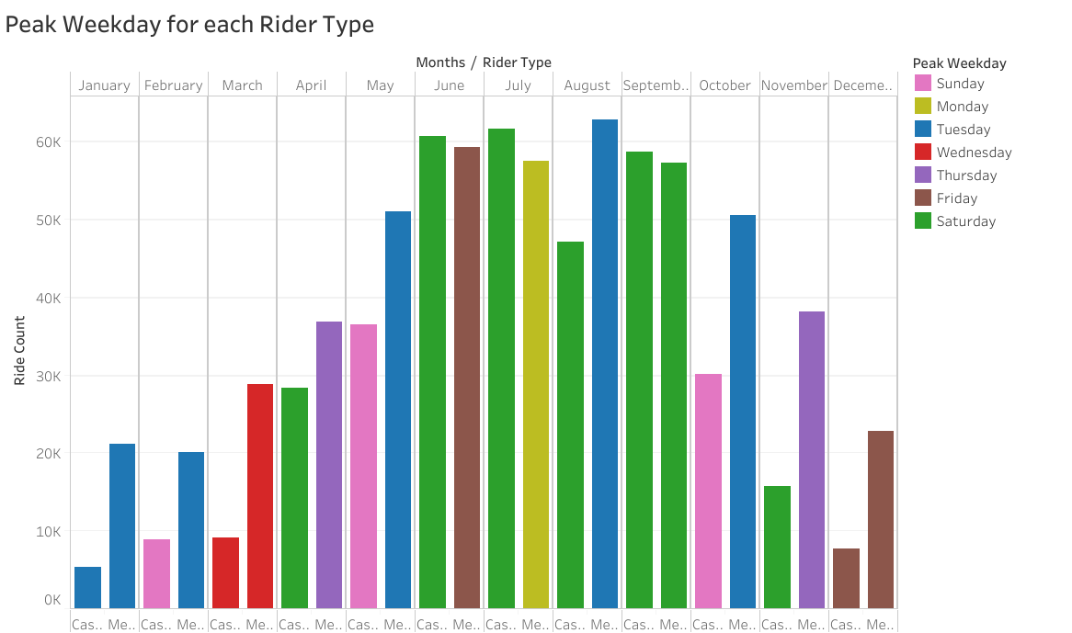
ANALYSIS BASED ON KEY METRICS
Peak weekday and hour for each rider type in each month
The results show that Tuesday and Saturday are popular days for casual riders and Cyclistic members.
The peak hour of day for Cyclistic members is 17:00 for all the 12 months. This is also true for casual riders except from November to February where the peak hour is 16:00.

Slide 9
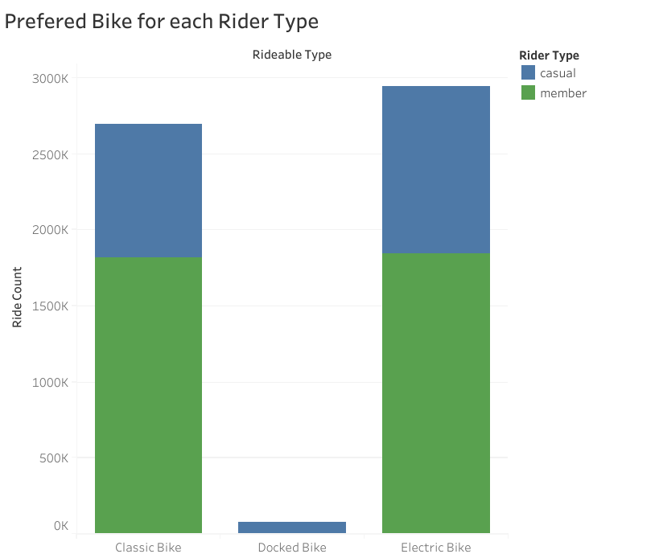
ANALYSIS BASED ON KEY METRICS
4. The preferred bike type for each rider
Cyclistic has three bike types available: classic bikes, docked bikes, and electric bikes.
Cyclistic members use the electric and classic bikes.
Electric bikes have a higher ride count, however, the difference in the ride counts for these two types is just about 20,000.
Casual riders on the other hand use all three bike types. However, the ride count for docked bikes is below a hundred thousand. Electric bikes also have the highest ride count for this group of riders.

Slide 10
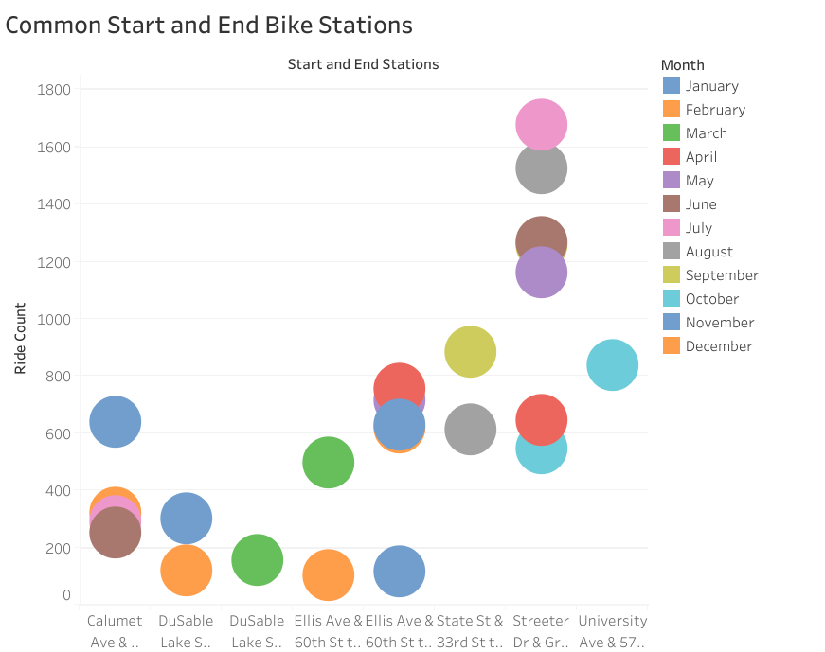
ANALYSIS BASED ON KEY METRICS
The common start and end stations for each rider type
The results show that some of the popular start and end stations for each rider type include Ellis Ave & 60th St to University Ave & 57th St, Calumet Ave & 33rd St to State St & 33rd St, among others.

Slide 11
RECOMMENDATIONS
Marketing efforts should be focused on weekdays with lower ride count to increase ridership on those days, especially for casual riders.
The availability of electric bikes and classic bikes should meet the demand, as these are the most popular bike types.
Different methods to increase the utilization of docked bikes by casual riders should be explored, as they currently have the lower ride counts compared to the other bike hours.
Strategies should be implemented to optimize operations during peak hours such as deploying more bikes at popular stations, ensuring availability and reducing wait time for riders.

Slide 12
REFERENCES
Motivate International Inc. (n.d.). Divvy Trip Data (2023). Retrieved from https://divvy-tripdata.s3.amazonaws.com/index.html
(Slide 1) Image Source: https://www.canva.com/ai-image-generator/ Copyright 2024, Canva.

Slide 13
THANK YOU

